Slide 1
Choose Alberta for Agri-Investment!

Slide 2
Table of Contents
Alberta has a Competitive Business Climate
A Robust Agri-Food Sector
Innovative Research and Development
Easy Access to World Markets
Efficient Transportation and Logistics
Funding programs
Important Links
Contact Information

Slide 3
Alberta’s COMPETITIVE Business climate

Slide 4
According to KPMG: Canada has the Lowest Location Costs among G7 Economies
Canada’s Business Costs Compared to the United States
14.6%
And Alberta’s agri-processing manufacturing costs are 9.5% lower than in USA.
Source: KPMG’s Guide to International Business Location Costs, 2016 edition. Data Retrieved on April 1, 2016 from: https://www.competitivealternatives.com/reports/compalt2016_report_vol1_en.pdf

Slide 5
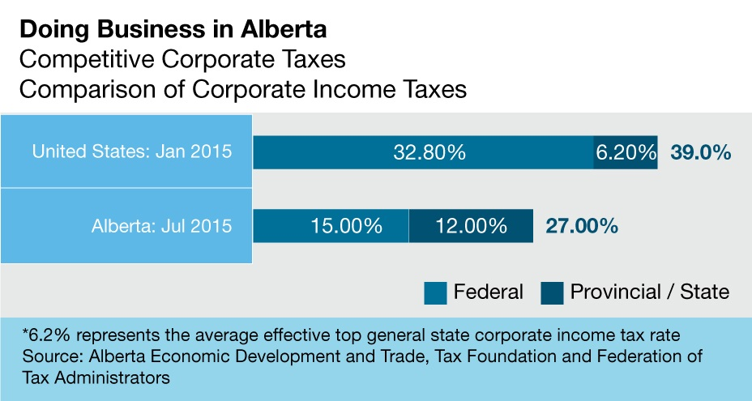
Competitive Tax Environment
Alberta businesses have among the lowest business taxes in Canada due to:
Low corporate tax rates
No provincial retail sales tax
No capital tax
No provincial payroll tax

Slide 6
A ROBUST AGRI-FOOD SECTOR

Slide 7
Alberta a Reliable Supplier of Commodities
Alberta’s reputation as a world-class producer of agricultural commodities and agri-food products is the cornerstone of its strengths in agri-food production.
Alberta enjoys a global reputation for safe, high-quality agriculture and agri-food products.
The reputation stems from accurate and consistent grading systems for grains and oilseeds, and various food safety initiatives for producers, processors, and consumers.
Source: Statistics Canada, CANSIM Table 0010010

Slide 8




The Agri-Food Industry is one of Alberta’s Main Economic Drivers
$6.6 b
73,200 jobs
Alberta’s real GDP for Agri-Food Industries in 2016
Alberta’s agri-food industry in 2016
Food and beverage processing largest Alberta manufacturing sector by revenue/sales
$14.6 billion in manufacturing sales, 22,400 jobs (50,800 in primary agriculture) $5.0 billion in exports of processed products.
Alberta's food and beverage manufacturing sales totaled a record $14.6 billion in 2016.
40,638 farms operate in Alberta (50.3 M acres of farmland) in 2016
Alberta is home to 671 Agri-food companies
Source: Statistics Canada CANSIM # 379-0030; Census of Agriculture, and Industry Canada

Slide 9
A Growing Agri-Food Industry

Slide 10
Alberta’s Agri-Food Industry is Export-Oriented
Alberta is the third largest exporter of agri-food products in Canada after Saskatchewan and Ontario.
In 2016, Alberta’s agri-food exports reached $9.9 billion.
Main products 2016 (46.7% of total agri-food exports): canola seed ($1.8 B), wheat (1.8 B), beef: fresh, chilled, frozen, incl. ofal (1.7 B), live cattle (excl. purebred) (623 M), crude canola oil (558 M)
Source: Statistics Canada
Data prepared by: Statistics and Data Development Branch, Economics and Competitiveness Division, Alberta Agriculture and Forestry
April 20, 2017; and Industry Canada Trade Data Online.

Slide 11
Sub-sector Strengths/Niche Areas
Business Environment
Alberta is home to 671 food processing companies of which over 200 are FF/NHP-related; over 48 core FF/NHP
Over 90% are located in Edmonton and Calgary
10% are located in Lethbridge, Red Deer, Olds
and rural Alberta
Business Strengths
product formulation
finished products, functional food or ingredients
raw ingredient producers
bioactive extraction
analytical testing
Many companies are active in more than one area
9

Slide 12
INNOVATIVE RESEARCH AND DEVELOPMENT

Slide 13
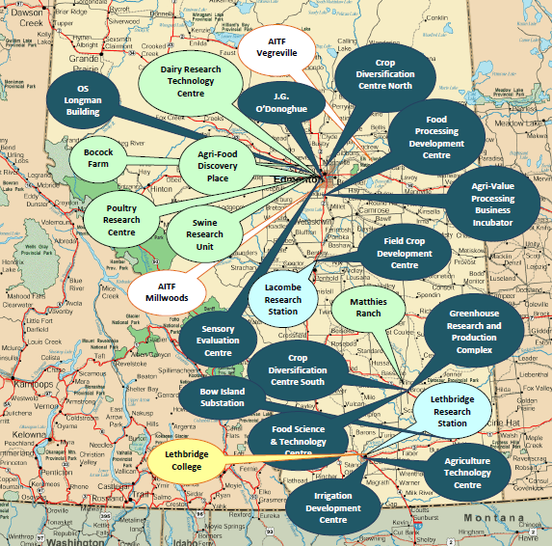
Alberta has over 22 research and innovation facilities which specialize in such areas as crops and cereals, poultry and swine research, agronomy, biomaterials and food safety.

Slide 14
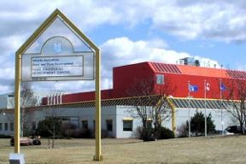
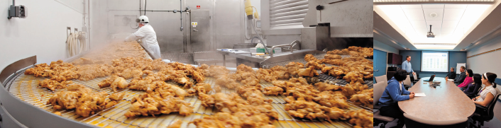
The Food Processing Development Centre
Agriculture and Forestry has a 6,000 square metre Food Processing Development Centre in Leduc which includes the Agrivalue Processing Business Incubator, a food product commercialization facility that is unique in Canada.
FPDC is undergoing a $10 M expansion that will add 2,300 sqm
12

Slide 15
Canada and Alberta have very generous tax incentives to conduct research and development.
Canada currently offers one of the most favorable tax treatments for R&D among the G7
Canada provides a system of tax credits and accelerated tax deductions for a wide-variety of R&D expenditures
Eligible costs include: salaries, overhead, capital equipment, and materials
The Alberta Scientific Research and Experimental Development (SR&ED) tax credit benefits businesses of all sizes and in all sectors that conduct research and development that will lead to new, improved or technologically advanced products or processes. The credit is worth 10 per cent of a company's eligible expenditures up to $4 million, for a maximum credit of $400,000. It will be refundable for all companies.
Source: Warda, Jacek, Innovation: Measuring Canada's R&D Tax Incentives: May 22, 2009. Data unchanged as of January 2012.
Note: Relative generosity is determined by dividing the after tax cost of performing $1.00 of R&D by 1 less the corporate tax rate. Results are indexed to the relative generosity of Canada's system of tax-based support for R&D. The higher the ratio the more competitive the tax system.
* Calculations based on large firms

Slide 16
EASY ACCESS TO WORLD MARKETS

Slide 17
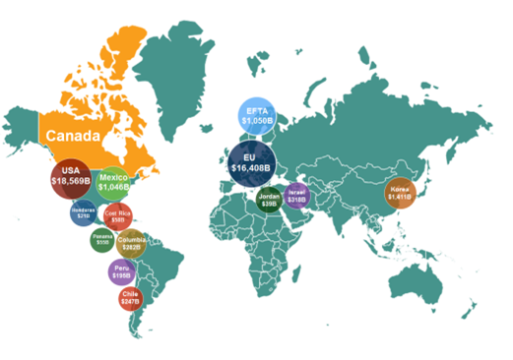
Excellent global market access for business
With the Canadian-European Union Comprehensive Economic and Trade Agreement (CETA) firms operating in Canada have preferred market access to 42 foreign countries.
Canada’s preferred market access represents approximately 1.2 billion consumers and nearly US$41.2 trillion or 54.8%, of global GDP.
Canada’s market access is supported by a reliable and efficient transportation system, providing for effective Canadian business participation in global supply chains.
Source: IMF World Economic Outlook April 2017/Think Canada presentation 2017

Slide 18
EFFICIENT TRANSPORTATION AND LOGISTICS

Slide 19
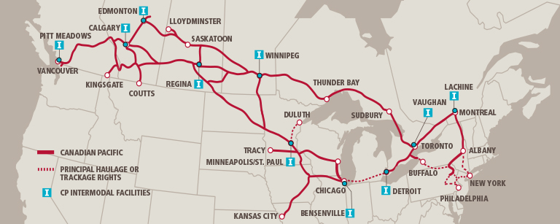
Efficient road, air and rail infrastructure
Alberta is well connected by road, air, and rail.
Edmonton and Calgary international airports are among the busiest in Canada and offer 24-hour cargo services, modern cargo terminals and U. S. pre-clearance facilities.
Alberta’s 30,800 km of provincial highways connect CANAMEX, a 6,000-kilometre corridor stretching from Alaska to Mexico as well as to two transcontinental railways companies, the Canadian National (CN) and the Canadian Pacific Rail (CPR).
Rail terminals strategically link Edmonton and Calgary with international ports on the west coast (Vancouver and Prince Rupert), the Great Lakes (Thunder Bay and Toronto), the St. Lawrence Seaway (Montreal), and the east coast (Halifax).
Source: map extracted from http://www.cpr.ca/en/choose-rail/intermodal-shipping

Slide 20
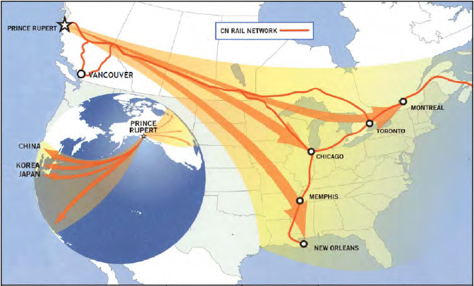
Alberta Offers Investors Easy Access to Fast Growing Markets in North America and Asia
The Prince Rupert Grain Terminal (PRGT) is located in the Port of Prince Rupert.
PRGT is jointly-owned and operated by Viterra, Cargill, and Richardson.
Prince Rupert Grain Terminal is closer to Asian markets by 36 hour sailing time compared to other pacific ports.
Annual Throughput Capacity: 7 million tonnes
Storage Capacity: 202,000 tonnes
Ship Loading Rate: 4,000 tonne/hour
Single berth depth: 14.5 m (low tide)
Ship size limit: 145,000 DWT (Suezmax)
On- terminal rail trackage: 17 km

Slide 21



Alberta’s Twelve International Offices
United Kingdom
China - Beijing
Washington, DC
Alberta China Office
Alberta Korea Office
Alberta Shanghai Office
Korea
Alberta India Office
Guangzhou
Shanghai
Mexico
Alberta Singapore Office
Japan
India
Taiwan
Hong Kong
Singapore

Slide 22
Select Funding Programs
Alberta Capital Investment Tax Credit (CITC) The CITC is a 2-year program that provides a non-refundable tax credit valued at 10% of a corporation’s eligible capital expenditures, up to $5 million. The CITC encourages companies to make timely capital investments by returning a percentage of the company’s costs, including the purchase of machinery, equipment and buildings. https://www.alberta.ca/capital-investment-tax-credit.aspx
The Work Force Development Program at Alberta Agriculture and Forestry (AF) provides assistance to address specific workforce issues in agricultural production and agri-processing activities. The Productivity Improvement Grant provides assistance to agri-processing companies to assess and adopt new technologies, processes and training that improve worker productivity. The Retention Grant provides assistance for employers to contract consultants to review, improve and develop retention strategies in order to reduce worker turnover and address workforce stability. AF will fund 50% of eligible activities to a maximum of $25,000.
The Canada-Alberta Job Grant is an employer-driven training program. This means that employers decide on who gets training and what type of training may be needed for new and existing employees. Employers are required to use a third-party training provider to deliver the formal training either onsite, online, or in a classroom setting. For more information visit: http://www.albertacanada.com/opportunity/employers/jobgrant.aspx#about
Agriculture Financial Service Corporation is a provincial crown corporation with a private sector Board of Directors that provides farmers, agribusinesses and other small businesses loans, crop insurance and farm income disaster assistance. For more information visit: https://www.afsc.ca/Default.aspx?cid=4&lang=1

Slide 23
Contact information
Dee Pannu
Director
Investment Attraction Section
Alberta Agriculture and Forestry
E-mail: dee.pannu@gov.ab.ca

